Slide 1

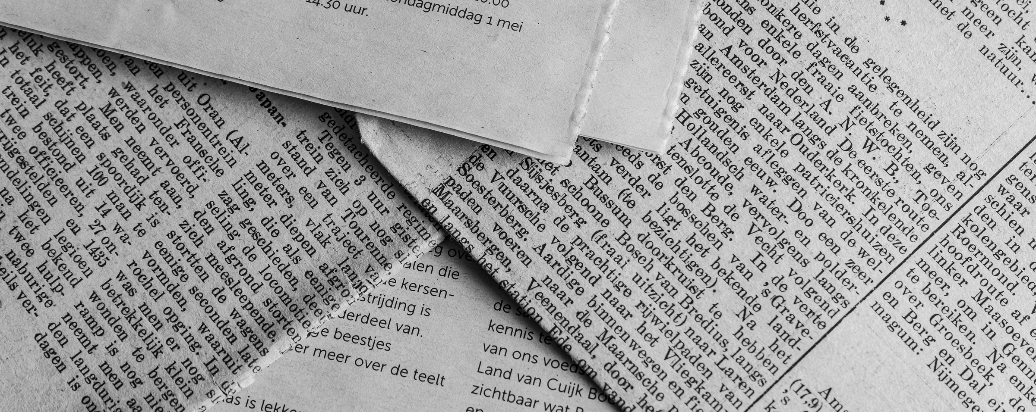
Sanya Gilhotra
Tuesday, April 9,2024
FAKE NEWS CLASSIFICATION

Slide 2

Sanya Gilhotra
Tuesday, April 9,2024
The Problem With Fake News
Fake news, defined as deliberately misleading or false information presented as news, has become a prevalent issue in the digital age.
Fake news undermines trust in traditional media sources, leading to skepticism and confusion among the public.
The spread of fake news threatens democratic processes by manipulating public opinion, distorting electoral outcomes, and undermining trust in democratic institutions.
Identifying and combating fake news is challenging due to its rapid dissemination, sophisticated manipulation techniques, and the sheer volume of online content.

Slide 3
Sanya Gilhotra
Tuesday, April 9,2024
Project Overview
Objective
The primary objective of this project is to develop a machine learning model capable of classifying news articles as either real or fake based on their content.
Dataset
The project utilizes two datasets: one containing genuine news articles and another containing fake news articles. These datasets are used for training and testing the classification model.
Model
The project employs a Decision Tree classifier trained on TF-IDF vectorized text data. TF-IDF (Term Frequency-Inverse Document Frequency) is used to convert text data into numerical vectors, capturing the importance of words in the documents.
Evaluation
The performance of the model is evaluated using metrics such as accuracy, confusion matrix, and classification report to assess its effectiveness in distinguishing between real and fake news articles.

Slide 4

Sanya Gilhotra
Tuesday, April 9,2024
Steps
Feature Engineering
Preprocessing
Model Training
Utilized NLTK for text preprocessing tasks, including lowercase conversion, special character removal, and stopwords elimination.
Employed lemmatization to reduce words to their base form, enhancing feature extraction.
Implemented techniques to clean and standardize the text data before feature extraction.
Implemented TF-IDF vectorization to convert text data into numerical features, capturing word importance.
Utilized vectorization to represent each document as a vector in a high-dimensional space.
Enhanced feature representation by capturing the frequency-inverse document frequency of words.
Trained a Decision Tree Classifier to distinguish between real and fake news articles.
Utilized the trained model to classify news articles based on their textual content.
Evaluated model performance using metrics such as accuracy, precision, and recall on the test dataset.

Slide 5
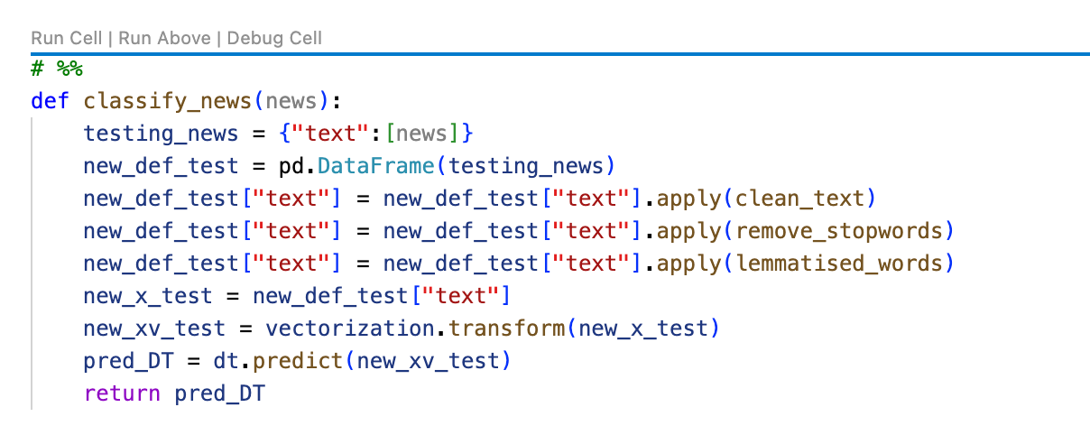
Sanya Gilhotra
Tuesday, April 9,2024
Code

Slide 6
Sanya Gilhotra
Tuesday, April 9,2024
THANK YOU FOR LISTENING!

